Slide 1



English Presentation
simultaneous & sequential
games
1

Slide 2


G
English Presentation
2
R
O
1. Sarah ouhocine
2. djillali boutouili
3. chloé Helain
U
P

Slide 3


DEFINITION
English Presentation
13
Simultaneous
Sequential
VS
Play at the same time
action without
knowledge of the
actions chosen by
other players
Play Turn by turn
action with
knowledge of the
actions chosen by
other players

Slide 4


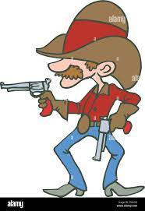
Examples of simultaneous games
English Presentation
14
Rock-Paper-Scissors
1.. 2.. 3.. Sun
Cowboy game
2 players.
the same time.
0 or 1 winner.
Multiple players.
the same time.
Unique winner.
2 players
the same time
1 winner and 1 loser.

Slide 5
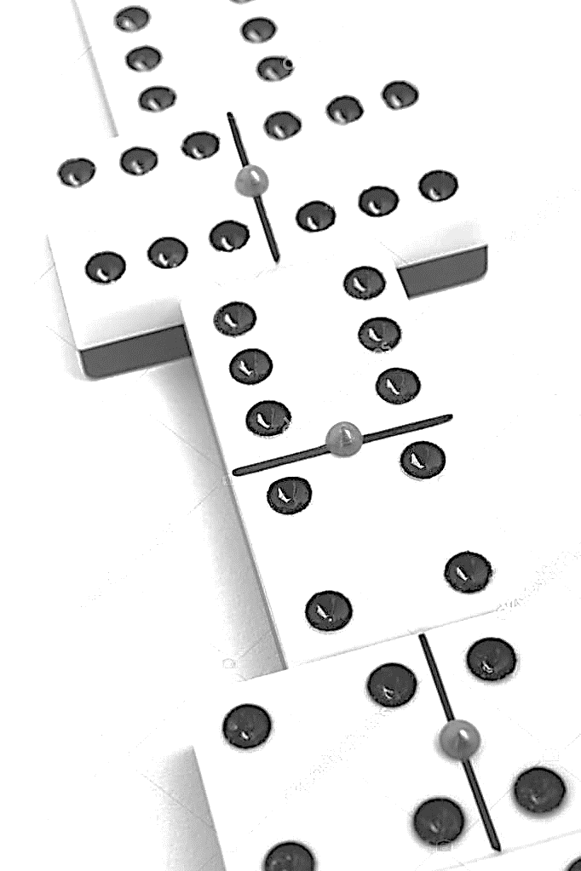

Examples of sequential games
English Presentation
15
Chess
Dominos
X|O
Board game.
2 players.
Turn by turn.
1 winner and 1 loser.
Board game.
2, 3 or 4 players.
Turn by turn.
Unique winner.
2 players.
Turn by turn.
0 or1 winner.

Slide 6

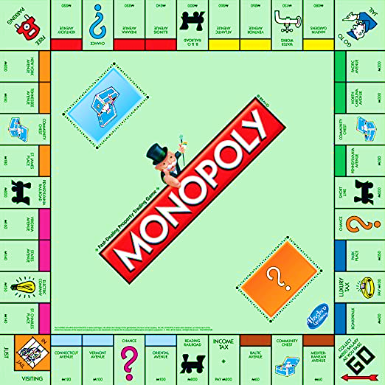
QUIZzZzZ
English Presentation
16

Slide 7
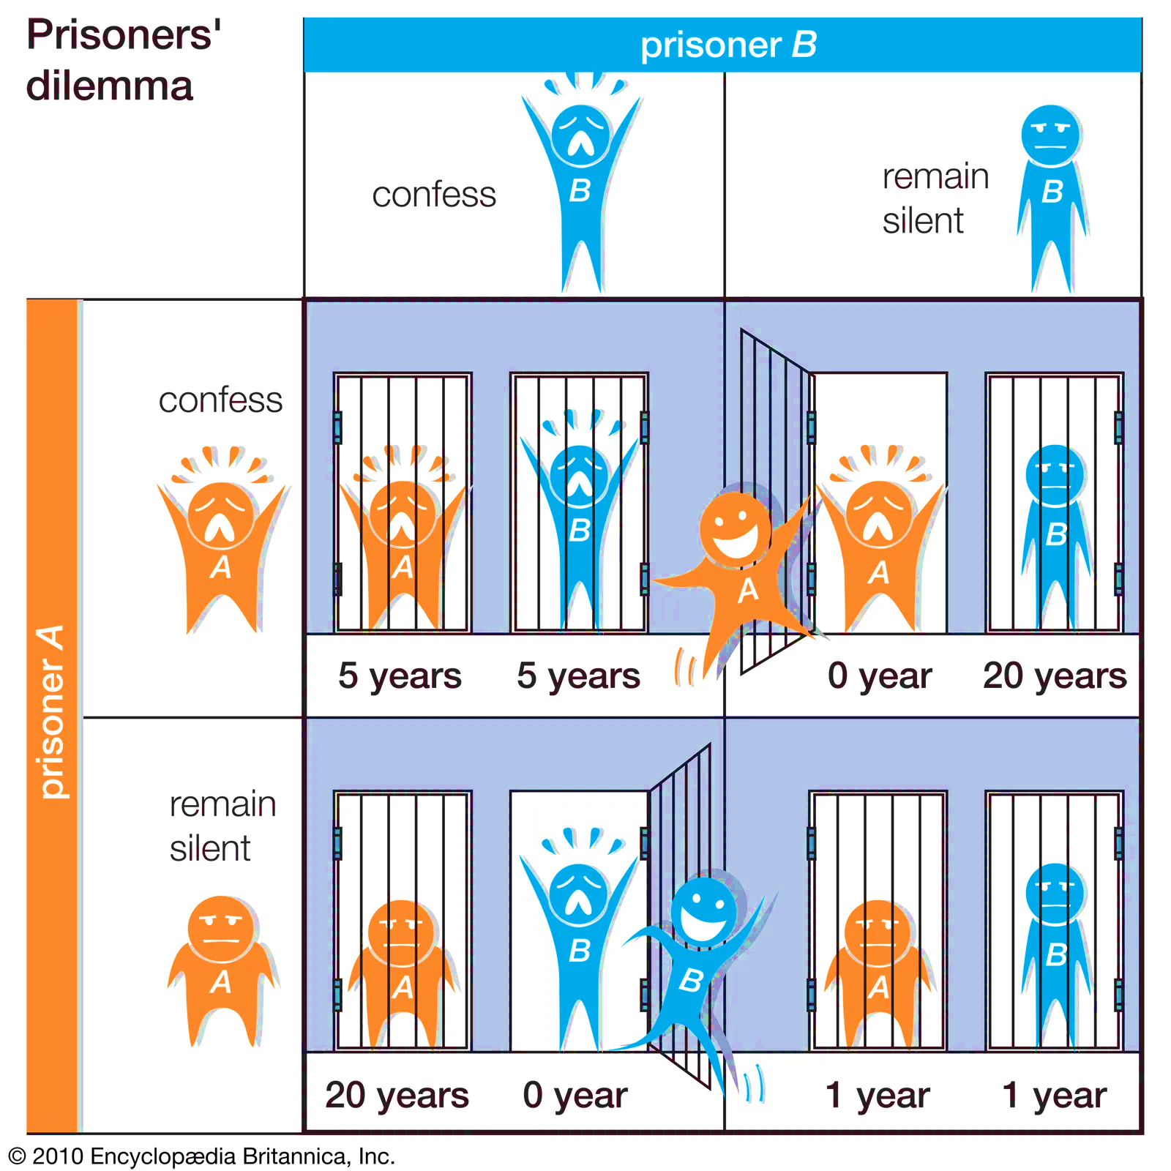
QUIZzZzZ
English Presentation
17

Slide 8
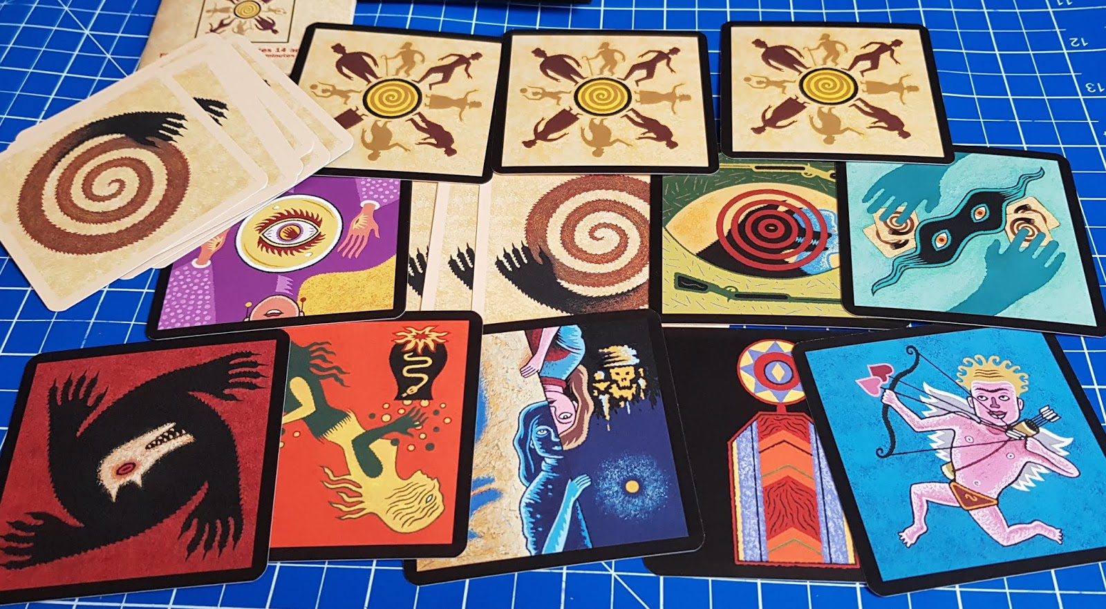
QUIZzZzZ
English Presentation
18

Slide 9

QUIZzZzZ
English Presentation
19

Slide 10
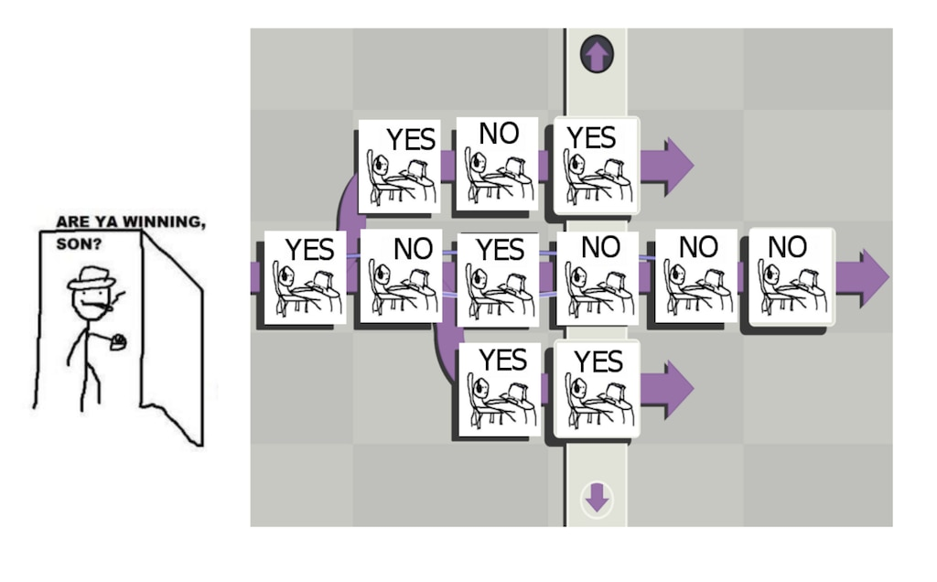
QUIZzZzZ
English Presentation
10

Slide 11
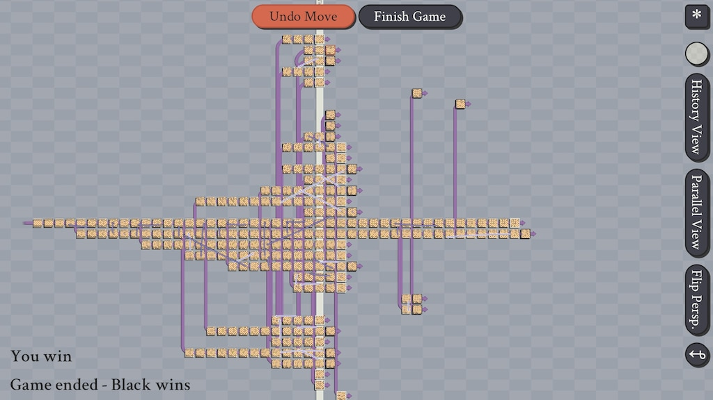
QUIZzZzZ
English Presentation
11

Slide 12

QUIZzZzZ
English Presentation
12

Slide 13

English Presentation
13
THANK
YOU
FOR
YOUR
ATTENTION

